Slide 2
Who is MetLife?

Slide 3
WHO IS METLIFE?
MetLife in the UK: Local expertise and global strength
A+
96%
340,000+
MetLife Europe d.a.c. has been in the UK since 2007, providing innovative protection, employee benefits, and retirement solutions
rating for MetLife Europe d.a.c. by Standard and Poor’s¹
claims satisfaction rating from our customers for 2021²
Individual Protection customers
¹ https://www.standardandpoors.com/en_EU/web/guest/home
² MetLife protection claims portfolio 2021

Slide 4
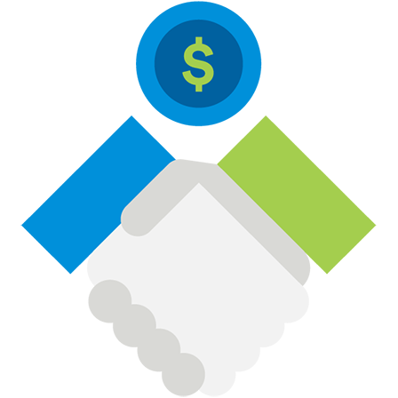
WHO IS METLIFE?
From then…
MetLife signs the UN Women’s Empowerment Principles and announce the formation of a MetLife Gender Equality Team partnering with the United Nations
Metropolitan Life paid the first death claim for a passenger on the Titanic. This was paid just 12 hours after rescue boat Carpathia docked in New York
Established the awards for medical research in Alzheimer’s disease which recognises scientific breakthroughs and research
The MetLife foundation made multiple charitable donations in the wake of the September 11 attacks
154 years ago, the Metropolitan Life Company was founded
A+
96%
340,000+
1868
1912
1986
2001
2020
MetLife Europe d.a.c. has been in the UK since 2007, providing innovative protection, employee benefits, and retirement solutions.
rating for MetLife Europe d.a.c. by Standard and Poor’s
claims satisfaction rating from our customers for 2021
Individual Protection customers
1906
1930
1993
2005
After the San Francisco earthquake, the Metropolitan Life US insurance company to send employees into the city to help pay claims on the spot
Throughout great depression Metropolitan Life aided thousands of farmers, meaning that over 7,000 farms were able to re-open
After rebranding the company name to MetLife in 1990, the logo became home to one of Manhattan’s most iconic skyline buildings- formally the PanAm building
MetLife is first awarded the DiversityInc “Top 50 Companies for Diversity”. MetLife continues to feature year on year

Slide 5
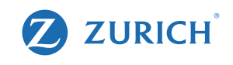
WHO IS METLIFE?
To now
2022
MetLife, Inc. is the largest life insurer in the United States based on life insurance in force
How does MetLife Inc. compare?
Company
Assets ($bn)
795.1
770.4
637.7
519.9
413.8
14.3
Source: Forbes - Global 2000 leading companies, values calculated April 2021 www.forbes.com

Slide 6
WHO IS METLIFE?
We pay
what we say
16,652
14,730
14,306
We pay claims in a timely manner, with no fuss and with an understanding of what has happened to your clients.
11,428
We’re
unique
8,899
On average we pay more than 65 accident and illness claims every single day.
2017
2018
2019
2020
2021
Source: MetLife UK protection claims annual portfolios 2016-2021

Slide 7
WHO IS METLIFE?
We pay
what we say
£14.5m
Total value of claims paid
We pay claims in a timely manner, with no fuss and with an understanding of what has happened to your clients.
We’re
unique
16,652
On average we pay more than 65 accident and illness claims every single day.
14,730
14,306
11,428
8,899
65,523
Total number of days paid for hospital stays
2017
2018
2019
2020
2021
Source: MetLife UK protection claims annual portfolios 2016-2021

Slide 8
01
WHO IS METLIFE?
We’re
award-winning
Diversity in Finance Awards 2020
Financial Adviser Service Awards 2020
Health Claims Forum 2020
Women in Protection and Health Awards 2022
Winner:
Provider of the Year
Winner 5* Award:
Pensions & Protection
Winner Customer Service Award: Michael Norris (Claims)
Winner:
Business Development Manager of the Year 2022
Winner Most Improved:
Pensions & Protection
Winner Rising Star: Jade Bowman (Claims)
Winner:
Women of the Year - Intermediary Support 2022

Slide 9
01
WHO IS METLIFE?
We care
Good Health and Wellbeing
Gender Equality
Decent Work and Economic Growth
Reduced Inequalities
Climate Action
MetLife Inc. has donated healthcare-related materials to hospitals, developed a global wellbeing platform, and has committed $25 million to COVID-19 relief.
First US-based insurer to sign United Nations Women’s Empowerment Principles. Partnership launched to increase women in management.
Engaged with 400 diverse Business Partners annually, paid out nearly $30 billion in claims and benefits. Responsible green investments in infrastructure and affordable housing.
MetLife Inc. promoted 22% of the leadership development programme for women, endorsed the COVID-19 5-Point Action Agenda, and committed $5 million to advance racial equity in the U.S.
11 new 2030 environmental goals, integrated climate risk in MetLife’s risk management framework, and issued the U.S. insurance industry’s first “green” funding agreement-backed note – a $750 million issuance.
Source: https://sustainabilityreport.metlife.com/content/dam/metlifecom/us/sustainability/pdf/report/2020/2020-sustainability-report.pdf

Slide 10
MetLife: supporting you when you need it most

Slide 11
Products and services are offered by MetLife Europe d.a.c. which is an affiliate of MetLife, Inc. and operates under the “MetLife” brand.
MetLife Europe d.a.c. is a private company limited by shares and is registered in Ireland under company number 415123. Registered office at 20 on Hatch, Lower Hatch Street, Dublin 2, Ireland. UK branch office at Invicta House, Trafalgar Place, Brighton BN1 4FR. Branch registration number: BR008866. MetLife Europe d.a.c. (trading as MetLife) is authorised and regulated by Central Bank of Ireland. Deemed authorised by the Prudential Regulation Authority. Subject to regulation by the Financial Conduct Authority and limited regulation by the Prudential Regulation Authority. Details of the Temporary Permissions Regime, which allows EEA-based firms to operate in the UK for a limited period while seeking full authorisation, are available on the Financial Conduct Authority’s website.
COMP2991.1.Oct22

