Slide 1
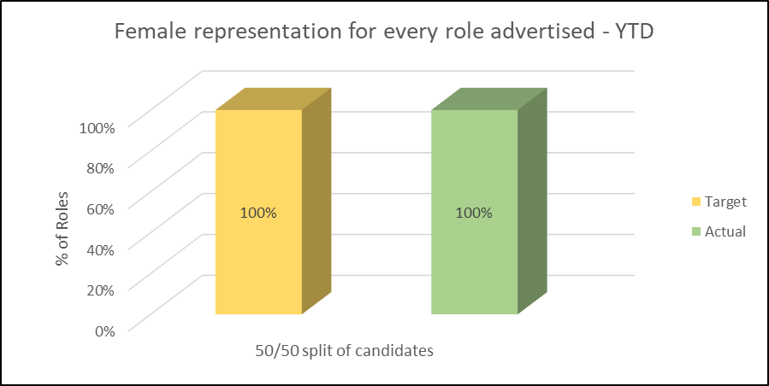
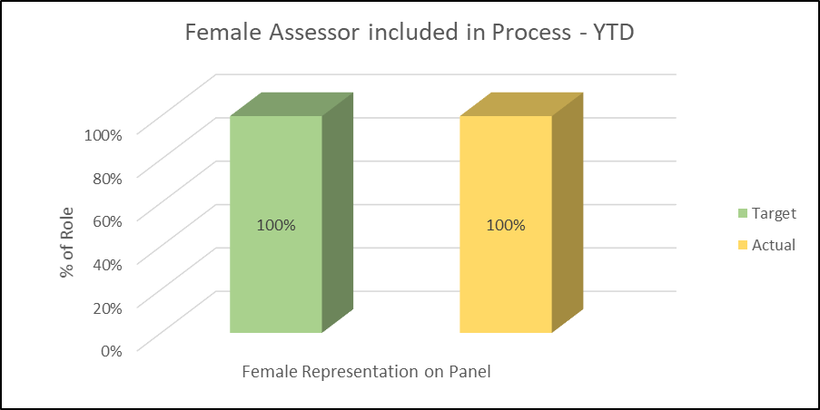
Women in Finance Charter - 2021
GOAL
RESULTS
2021 Target
Female representation for every role advertised
100% unbiased resourcing practices, including: equal opportunities; gender mixed agencies; mix of male and female assessors; recruitment training for hiring managers
HIRE

Slide 2
Women in Finance Charter - 2021

Slide 3
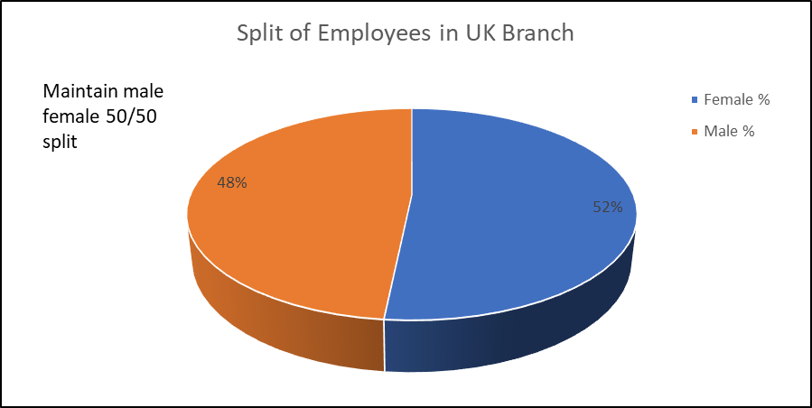
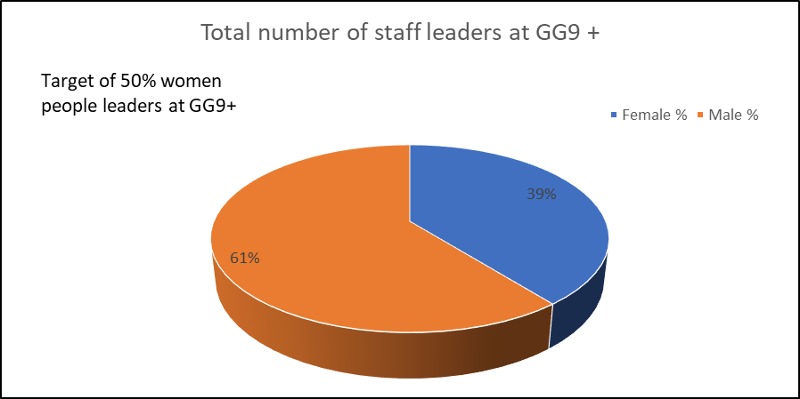
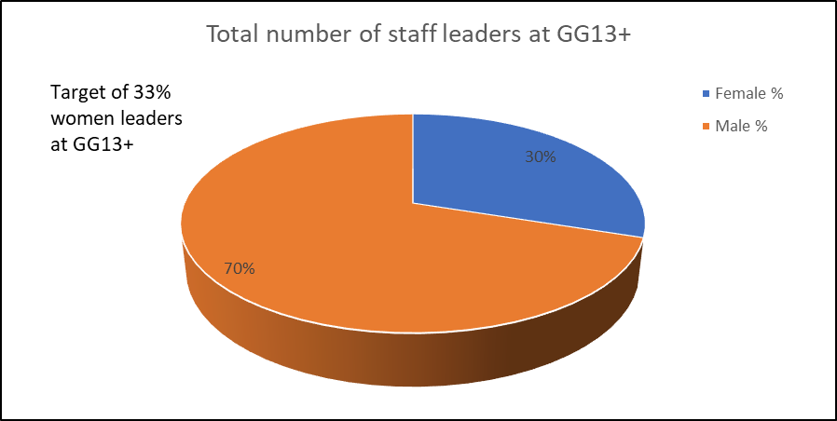
Women in Finance Charter - 2021
GOAL
RESULTS
2021 Target
Maintain of 50/50 split of male and female employees within UK Branch
Target of 50% women people leaders at GG9 and above within UK Branch​
Target of 33% women leaders at GG13 and above within UK Branch​​
ENGAGE

Slide 4
Women in Finance Charter - 2021

Slide 5
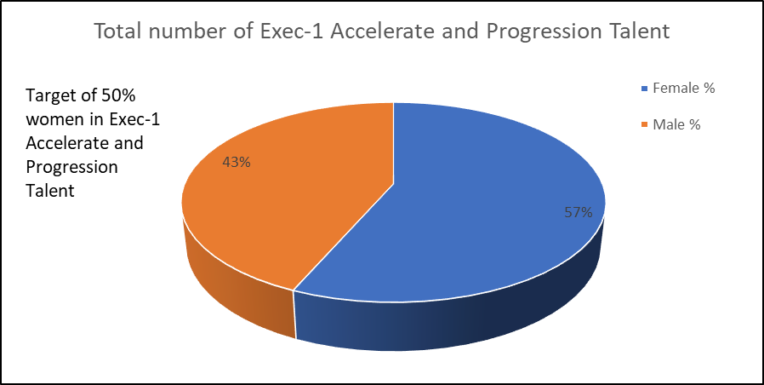
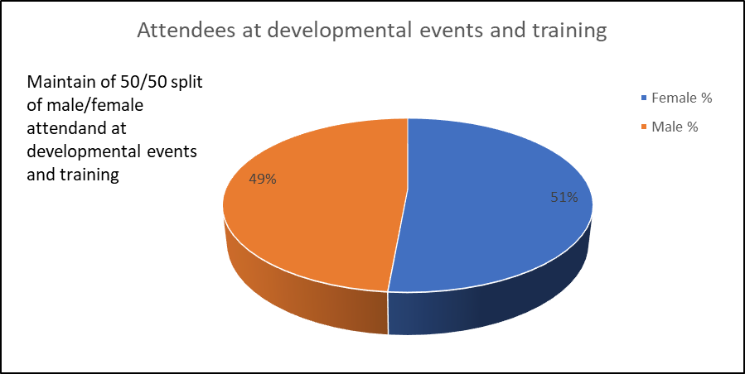
Women in Finance Charter - 2021
GOAL
RESULTS
2021 Target
Target of 50% women in Exec-1 Accelerate and Progression Talent
Maintain of 50/50 split of male/female attendance at developmental events and training
DEVOLOP

Slide 6
Women in Finance Charter - 2021

