Slide 1
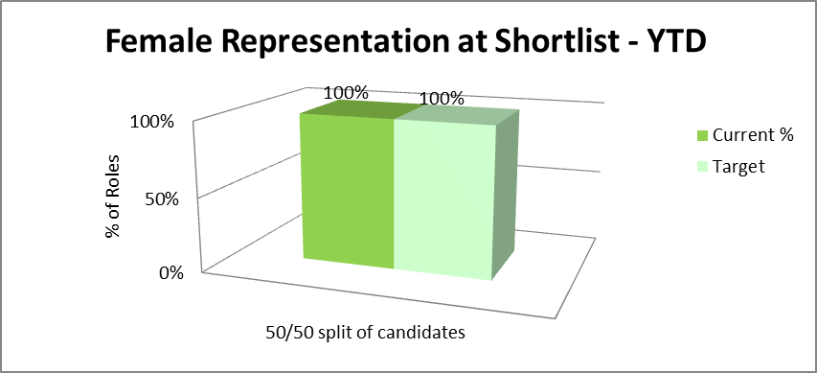
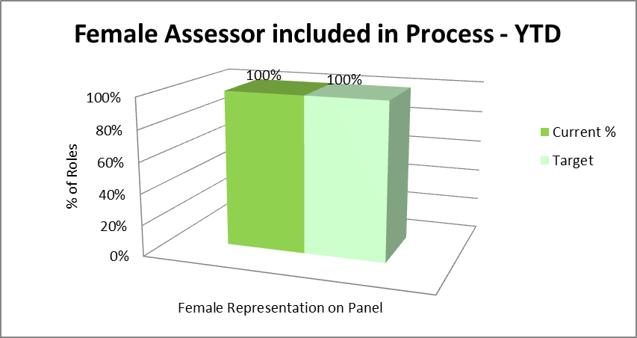
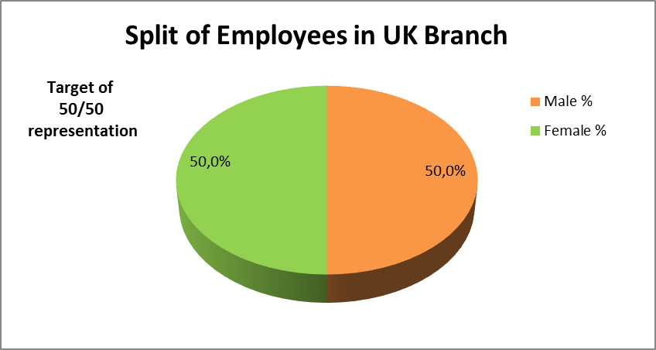
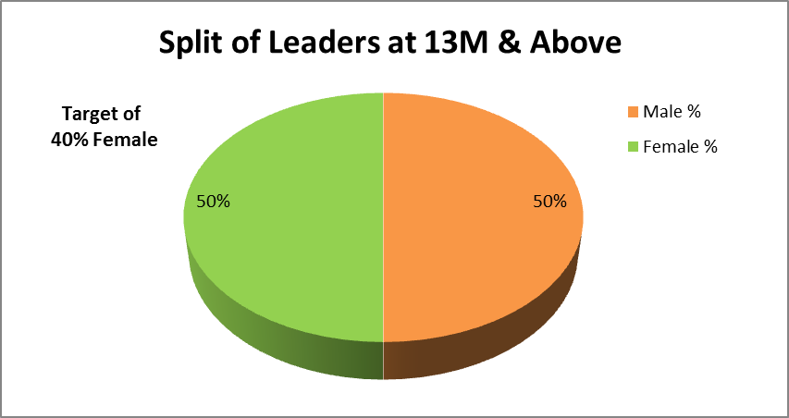
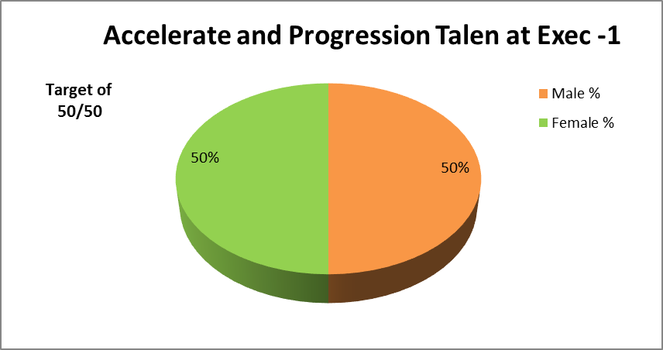
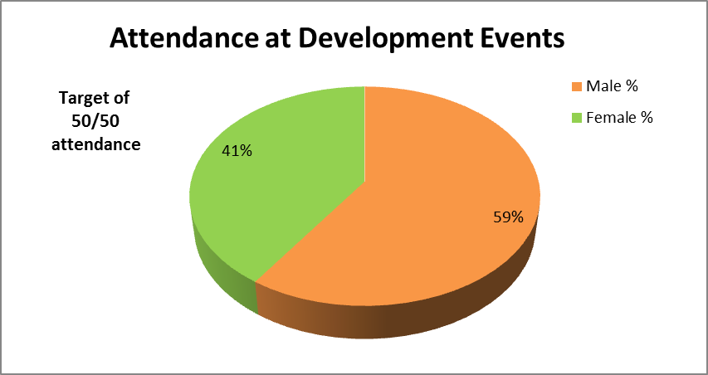
Women in Finance Charter - 2018
GOAL
RESULTS
2018 Target
Female representation for every role advertised
100% unbiased resourcing practices including equal opportunities, gender mixed agencies, mix of female and male assessors, and recruitment training for hiring managers
2018 Target
Target of 50/50 split of male and female employees within the UK Branch.
Target of 50% female leaders and GG13 and above within the UK Branch
DEVELOP ENGAGE HIRE
2018 Target
Target 50% women in Exec-1 Accelerate and Progression Talent
Target of 50/50 split of male/female attendance at developmental events and training

