Slide 1

Social media asset pack

Slide 2
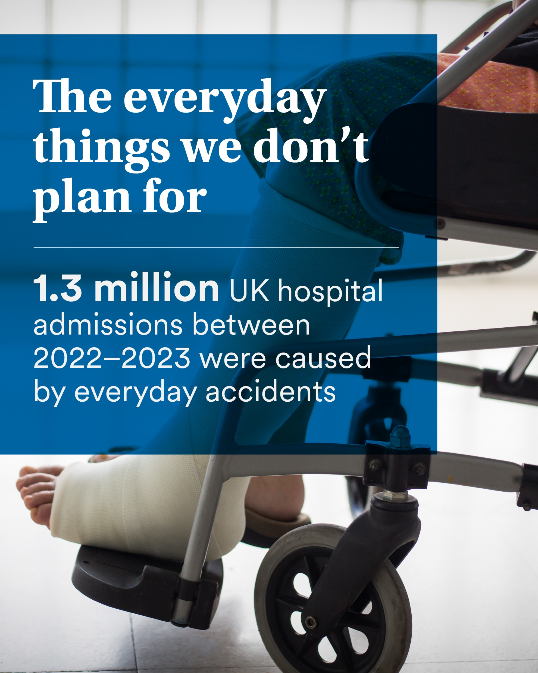
Post 1: The everyday things we don’t plan for
Recommended caption copy:
According to MetLife’s Everyday Risk Report, 1.3 million hospital admissions in the UK between 2022–2023 were caused by everyday accidents such as falls, trips, bumps, food poisoning and transport incidents.
If an unexpected injury meant time off work, would your income still cover the essentials?
Message me for a quick protection check to ensure you have a safety net in place for everyday risks.
Right click and save image. You can then upload to your socials

Slide 3

Post 2: Most claims aren’t for what you think
Recommended caption copy:
MetLife’s Everyday Risk Report shows that everyday injuries like fractures, muscle tears, back strain and concussion are far more common than most people realise, and these are exactly the types of events that often stop people working.
Real life = real risks.
Curious what this kind of cover would look like for you? Contact me to review your protection package.
Right click and save image. You can then upload to your socials

Slide 4

Post 3: Time off work happens more than we think
Recommended caption copy:
From back pain to fractures and sprains, everyday injuries frequently lead to unplanned time off work. The Everyday Risk Report shows that hospital stays from falls, trips and bumps last an average of 4.7 days, nearly a full working week.
How long would your savings last if it happened to you?
Message me for a quick income protection conversation.
Right click and save image. You can then upload to your socials

Slide 5

Post 4: Your income is your biggest asset
Recommended caption copy:
Your home, car and phone are insured… but is your income protected?
The Everyday Risk Report highlights how everyday accidents, things as simple as a fall or a sports injury, can have real financial consequences if income is suddenly impacted.
Your income is what pays for everything else, why leave it exposed?
Message me to find out more about the options you have to protect your income.
Right click and save image. You can then upload to your socials

