Slide 1
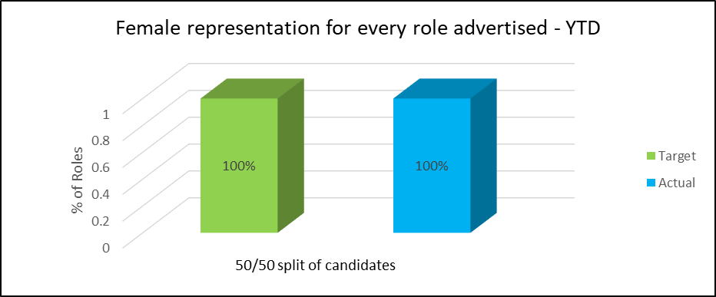
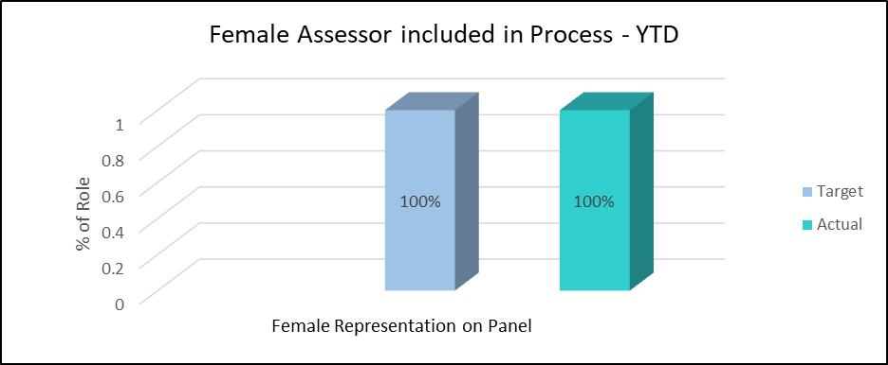
Women in Finance Charter - 2023
GOAL
2023 Target
Female representation for every role advertised
100% unbiased resourcing practices, including: equal opportunities; gender mixed agencies; mix of male and female assessors; recruitment training for hiring managers
HIRE
RESULTS

Slide 2
Women in Finance Charter - 2023
ENGAGE
GOAL
2023 Target
Maintain of 50/50 split of male and female employees within UK Branch
Target of 50% women people leaders at GG9 and above within UK Branch​
Target of 33% women leaders at GG13 and above within UK Branch​​
RESULTS
Target of 33%
Women
leaders
at GG13+

Slide 3
Women in Finance Charter - 2023
GOAL
DEVOLOP
2023 Target
Target of 50% women in Exec-1 Accelerate and Progression Talent
Maintain of 50/50 split of male/female attendance at developmental events and training
RESULTS

